Slide 1
Min 90-105: Bias-Correcting Meteorological Forecasts with simple ML
Learning Objectives (Wilks Ch7, Géron Ch3+4):
Distinguish dynamical from statistical forecasting
Understand Model Output Statistics
Be aware of forward/backward selection to choose inputs for your ML model
Know how to regularize a linear model
Define prediction intervals and think about uncertainty

Slide 2
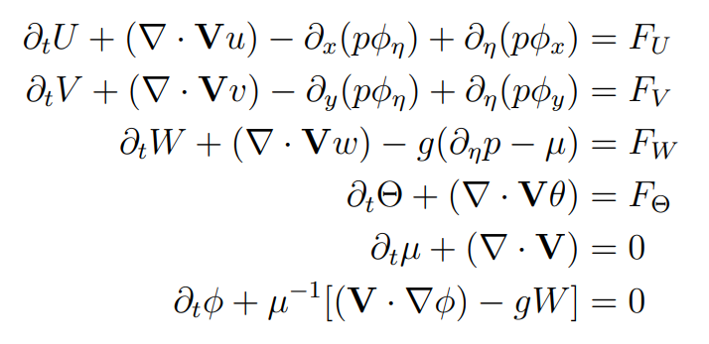
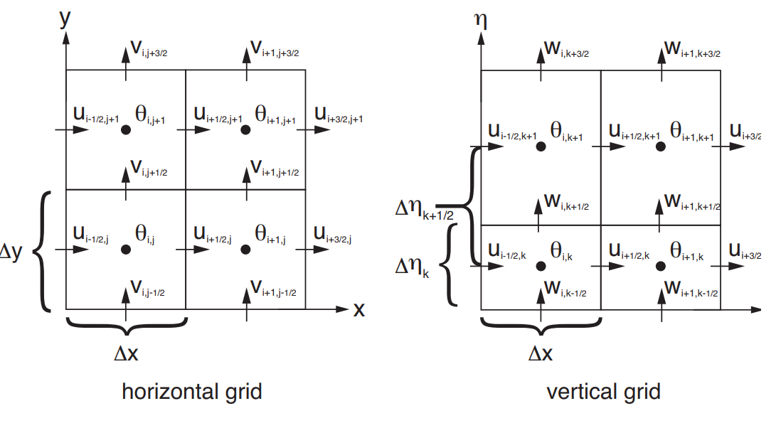
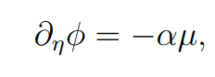
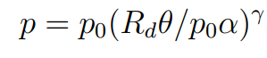
Dynamical Forecasting
Statistical Forecasting
Data
Past
Present
Training
Prediction
Notes:
Distinguish dynamical from statistical forecasting

Slide 3
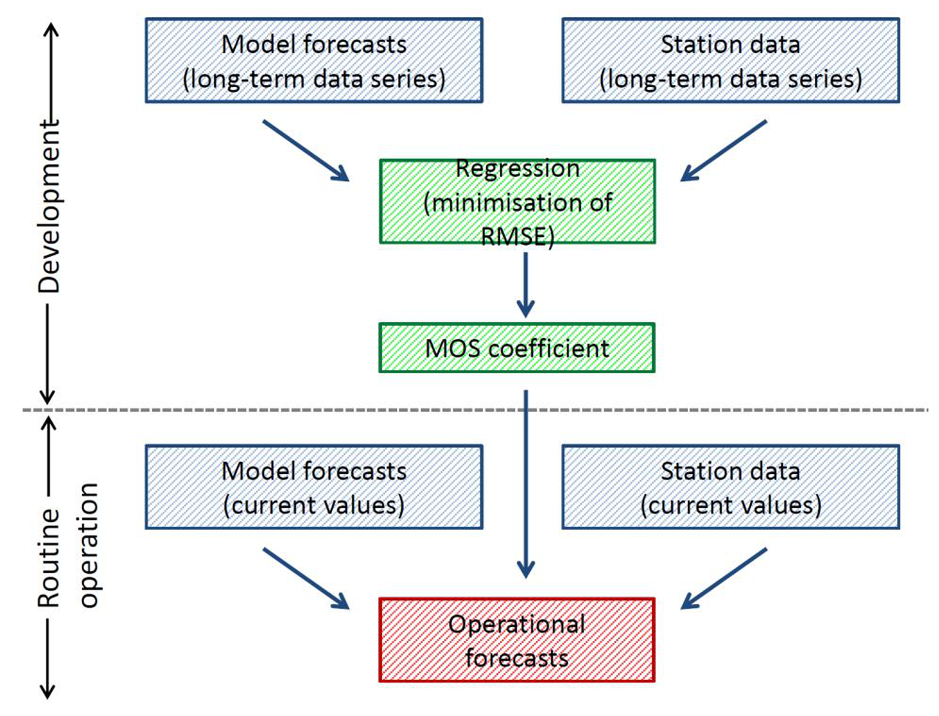

Model Output Statistics
(MOS)
MOS is machine learning applied to:
Past observations
Past forecasts
To statistically correct future forecasts
Source: DWD

Slide 4
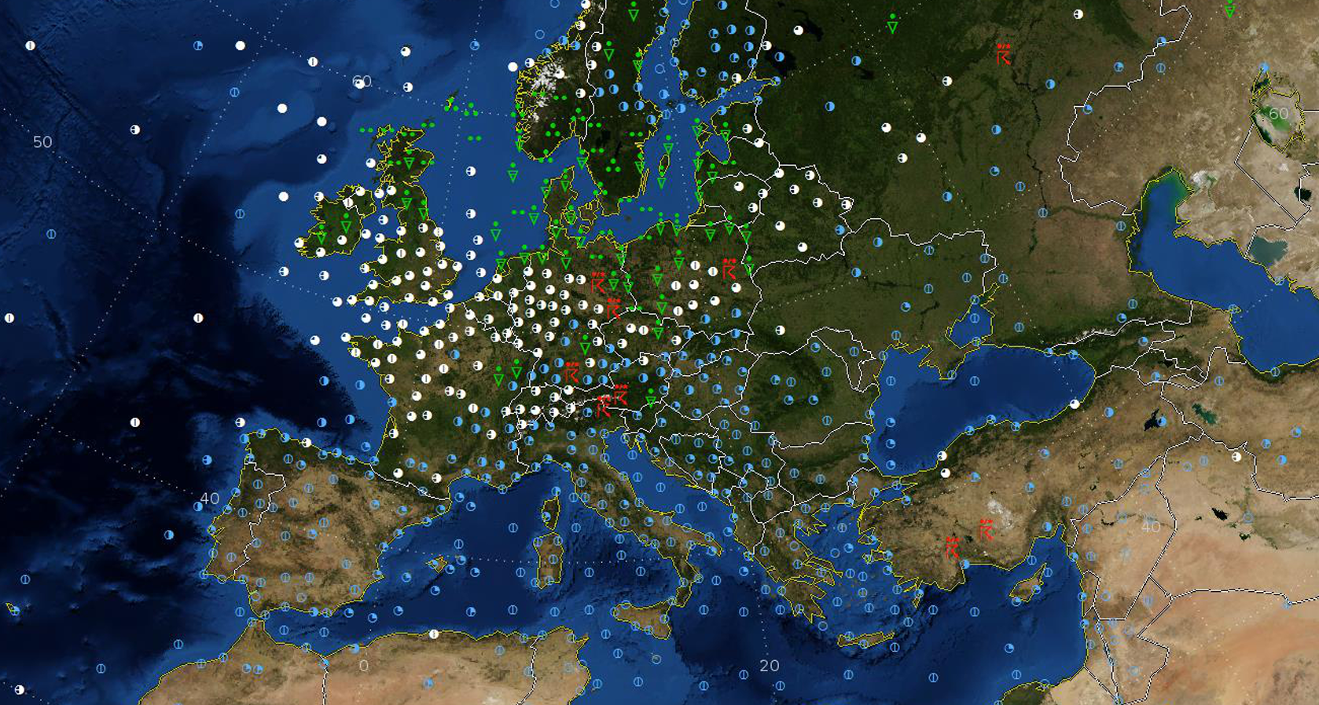
MOS (Model Output Statistics) is a statistical postprocessing method that helps correct the systematic errors of the raw dynamical forecast outputs. The MOS approach modifies the classical statistical forecastings (large multiple regression equations) by considering dynamical forecasts available at the time the forecast must be issued, related to the future time being forecast.
MOS extends classical statistical forecasting by including dynamical forecasts available at the time the forecast must be issued, but which apply yo the future time being forecast. The influences of dynamical models can be included directly in the regression equations.
MOS: The statistical relationships between deterministic forecast outputs and observations
We can use MOS to figure out the systematic biases of a particular weather model. Then we should presumably get more accurate predictions by removing this bias.

Slide 5
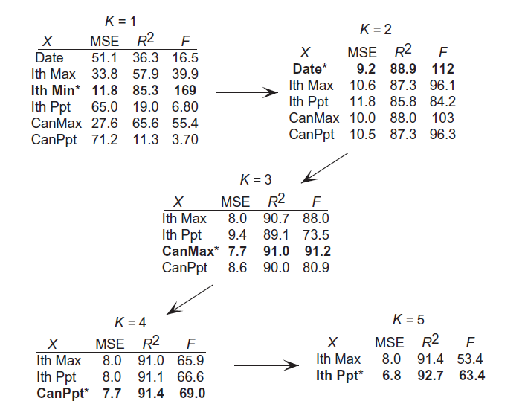
Forward Selection
Backwards Elimination
Starts by fitting with all inputs
Eliminate the least important input (e.g., based on its weight)
Fit with all inputs minus eliminated
Repeat
In both cases, this can be done using
Sequential Feature Selector in scikit-learn

Slide 6
Alternative methods to select inputs/predictors
Domain knowledge: You may already know which inputs are most informative, and which inputs are redundant.
As an example, for the case of land-use regression (which aims to predict the concentration of certain pollutants, like NOx), it is known or expected that variables such as emission by factories (if exist in the study area), traffic data, vegetation, population, and meteorological variables such as wind speed, precipitation, and temperature have an impact on the concentration of the pollutant under study. However, as an example, the price of a certain stock, or the number of patients in hospitals (which may be impacted by the pollutant concentration, and will not affect it) do not seem to be suitable predictors.
Direct knowledge of the phenomenon one wishes to study through these methods enables one to choose the most consistent predictors, based on which factors most influence the phenomenon. For example, environmental predictors such as altitude, exposure, temperature, etc. can be used for permafrost detection.

Slide 7
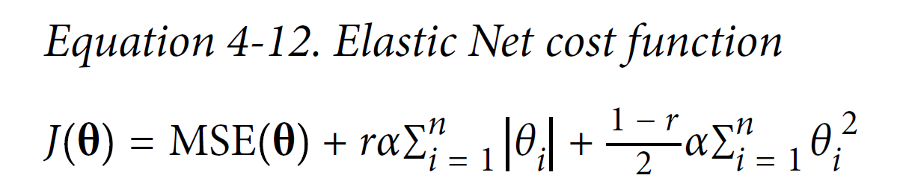

Alternative methods to select inputs/predictors
Domain knowledge: You may already know which inputs are most informative, and which inputs are redundant.
Regularization: Elastic Net
Scale the inputs before regularizing the coefficients!
Performance
L1 Norm
(Lasso)
L2 Norm
(Ridge)

Slide 8

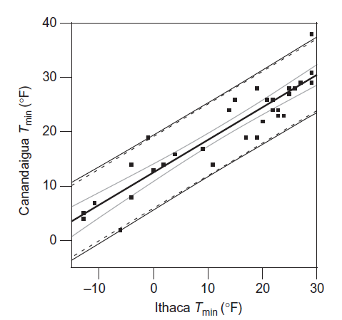
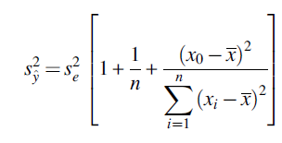
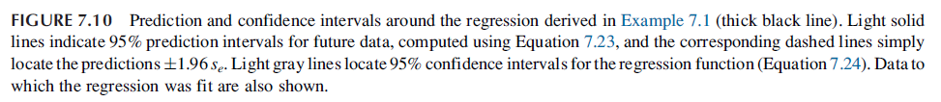
Adding uncertainty to your model: Confidence Intervals
Glacier_Mass_Loss = 0,258315864 x (Scaled_Insolation)
In practice, confidence intervals are implemented as part of the classification/regression model
class you will be using

Slide 9
Legacy Slides

Slide 10
Extra Questions
In what way can be include statistical methods/knowledge in dynamical models, and can we improve subseasonal dynamical forecasts by combining statistics and dynamics?
Does applying ML techniques in purely classical statistical weather forecasting improve their performance at larger lead times when compared to NWP/dynamical forecasts? If yes, What are the factors that help to improve the predictions? If not, what could be the reasons and how can we improve the predictions?

Slide 11
Min 105-115: Review Moodle Quiz
Learning Objectives (Géron Ch3+4):
Distinguish classification from regression
Define a loss/cost function
Understand how to train a logistic/softmax regression for binary/multiclass classification
Know how to benchmark a classifier
Understand how to train a (multiple) linear regression
Know how to benchmark a regression model
Notes:
Questions?
Not graded

Slide 12
Start thinking about your final project and book a one-on-one meeting on Friday, March 11th in the afternoon
The final project’s goal is to answer a well-defined scientific question by applying one of the ML algorithms introduced in class on an environmental dataset of your choice (e.g., related to your Masters thesis or your PhD research).
Can you think of a large environmental dataset linked to a scientific question you are passionate about?
In the affirmative, how could you format the dataset to facilitate its manipulation in Python?
In the negative, consider browsing the list of benchmark datasets maintained by Pangeo (http://mldata.pangeo.io/index.html) or browse the class syllabus’ datasets
Notes:
Questions?

